Slide 1
CAP275: Data Communication and Networking Unit-2: Physical Layer – Modulation and Multiplexing
Ajay Kumar Bansal
School of Computer Applications
Lovely Professional University

Slide 2
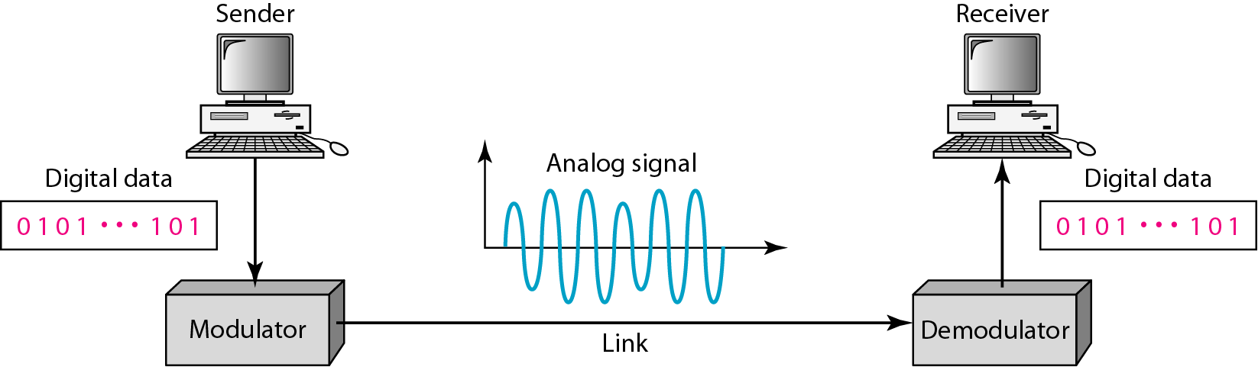
Digital to Analog Conversion
Digital data needs to be carried on an analog signal.
A carrier signal (frequency f_{c}) performs the function of transporting the digital data in an analog waveform.
The analog carrier signal is manipulated to uniquely identify the digital data being carried.

Slide 3
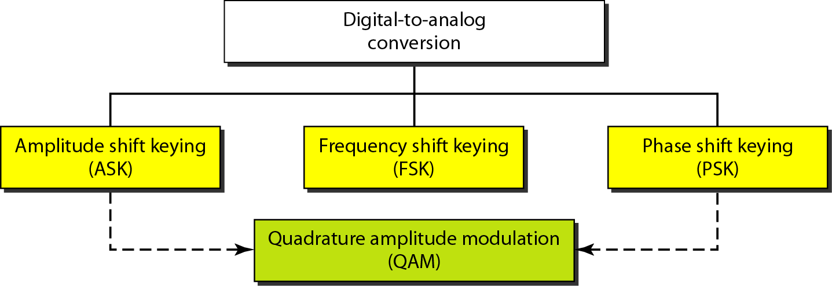
Types of Digital-to-Analog Conversion

Slide 4

Note
Bit rate, N, is the number of bits per second (bps).
Baud rate is the number of signal elements per second (bauds).
In the analog transmission of digital data, the signal or baud rate is less than or equal to the bit rate.
S=Nx1/r bauds
Where r is the number of data bits per signal element.

Slide 5
An analog signal carries 4 bits per signal element. If 1000 signal elements are sent per second, find the bit rate.
Solution
In this case, r = 4, S = 1000, and N is unknown. We can find the value of N from

Slide 6
An analog signal has a bit rate of 8000 bps and a baud rate of 1000 baud. How many data elements are carried by each signal element? How many signal elements do we need?
Solution
In this example, S = 1000, N = 8000, and r and L are unknown. We find first the value of r and then the value of L.

Slide 7
Amplitude Shift Keying (ASK)
ASK is implemented by changing the amplitude of a carrier signal to reflect amplitude levels in the digital signal.
For example: a digital “1” could not affect the signal, whereas a digital “0” would, by making it zero.
The line encoding will determine the values of the analog waveform to reflect the digital data being carried.
Bandwidth of ASK
The bandwidth B of ASK is proportional to the signal rate S.
B = (1+d)S
“d” is due to modulation and filtering, lies between 0 and 1.

Slide 8
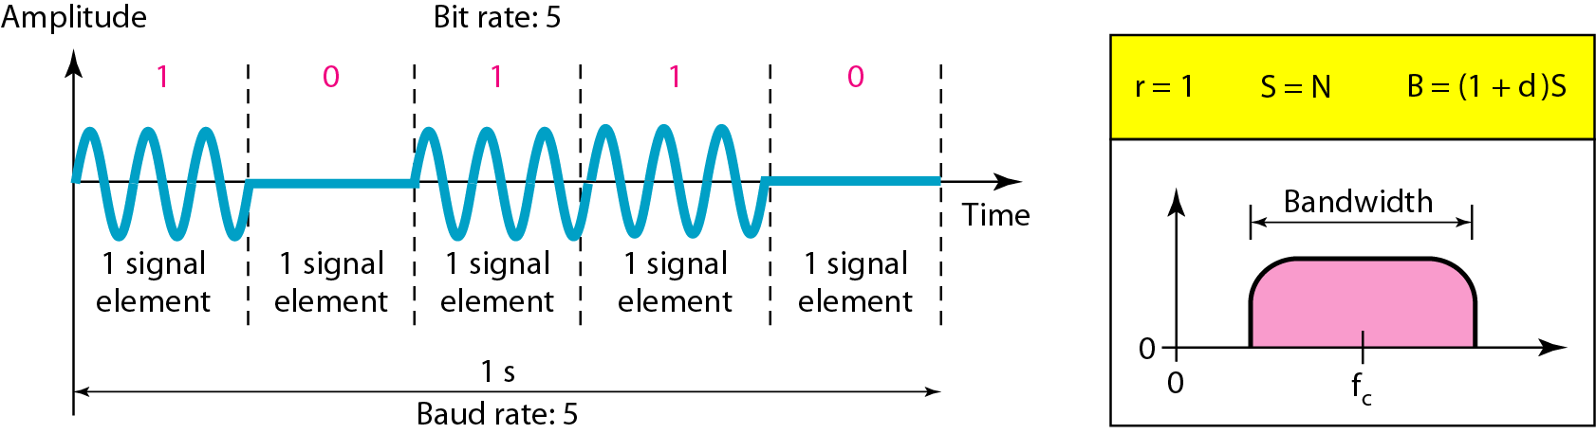
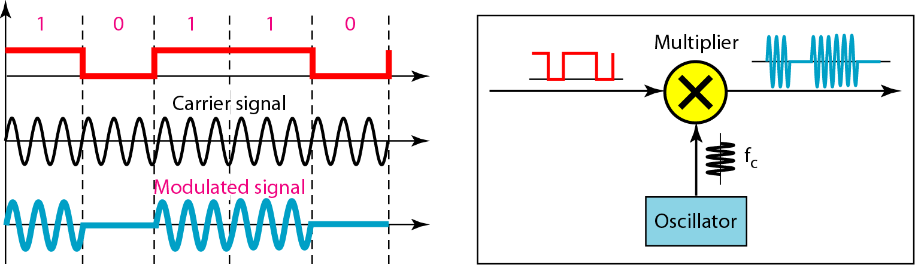
Binary Amplitude Shift Keying

Slide 9
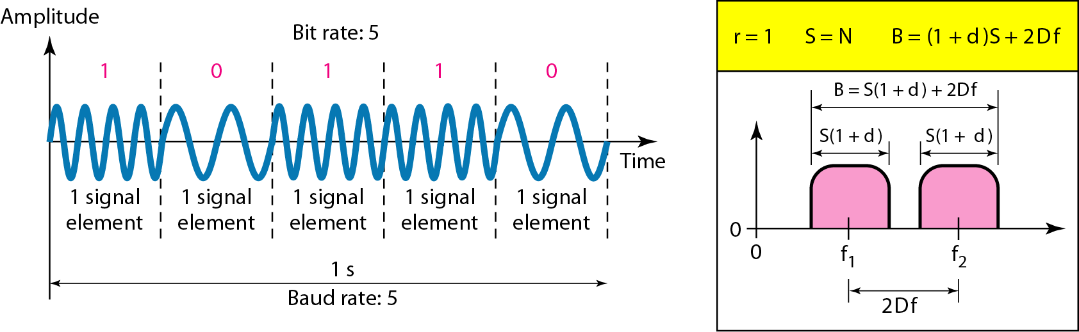
Frequency Shift Keying
The digital data stream changes the frequency of the carrier signal, f_{c}.
For example, a “1” could be represented by f₁=f_{c} +Δf, and a “0” could be represented by f₂=f_{c}-Δf.
Bandwidth of FSK
If the difference between the two frequencies (f₁ and f₂) is 2Δf, then the required BW B will be:
B = (1+d)xS +2Δf

Slide 10
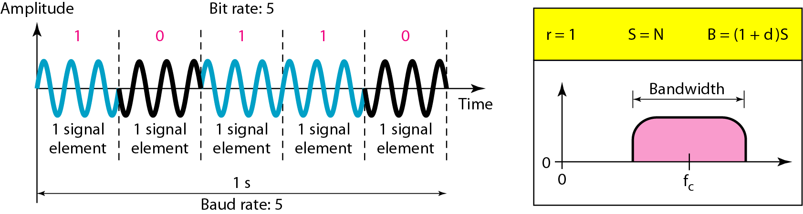
Phase Shift Keyeing
We vary the phase shift of the carrier signal to represent digital data.
The bandwidth requirement, B is:
B = (1+d)xS
PSK is much more robust than ASK as it is not that vulnerable to noise, which changes amplitude of the signal.

Slide 11
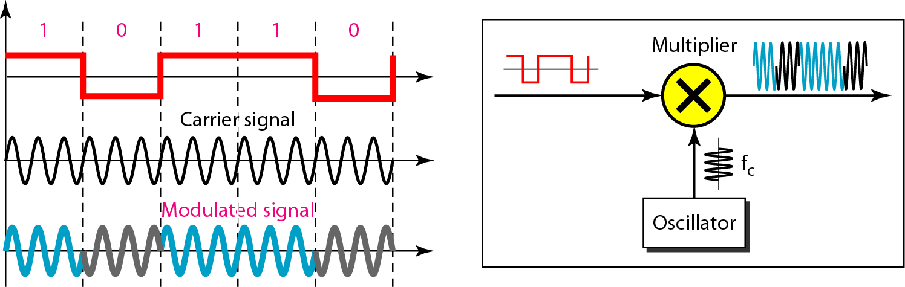
Figure 5.10 Implementation of PSK

Slide 12
Quadrature PSK
To increase the bit rate, we can code 2 or more bits onto one signal element.
In QPSK, we parallelize the bit stream so that every two incoming bits are split up and PSK a carrier frequency. One carrier frequency is phase shifted 90º from the other - in quadrature.
The two PSKed signals are then added to produce one of 4 signal elements. L = 4 here.

Slide 13
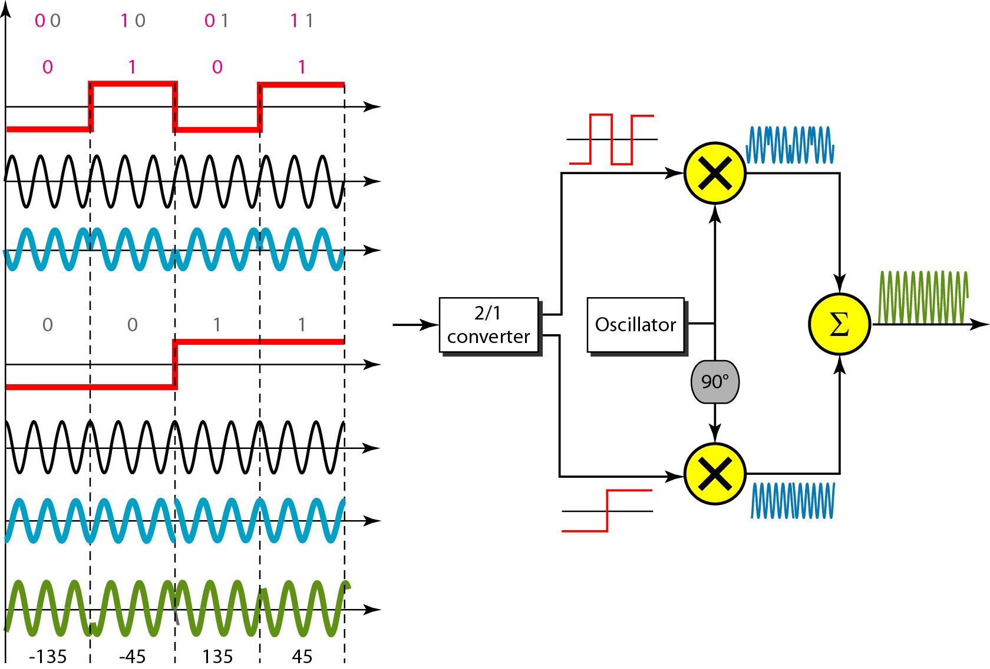
QPSK and its implementation

Slide 14
Note
Quadrature amplitude modulation is a combination of ASK and PSK.

Slide 15
MULTIPLEXING
Whenever the bandwidth of a medium linking two devices is greater than the bandwidth needs of the devices, the link can be shared.
Multiplexing is the set of techniques that allows the (simultaneous) transmission of multiple signals across a single data link.
As data and telecommunications use increases, so does traffic.
Frequency-Division Multiplexing
Wavelength-Division Multiplexing
Time-Division Multiplexing

Slide 16
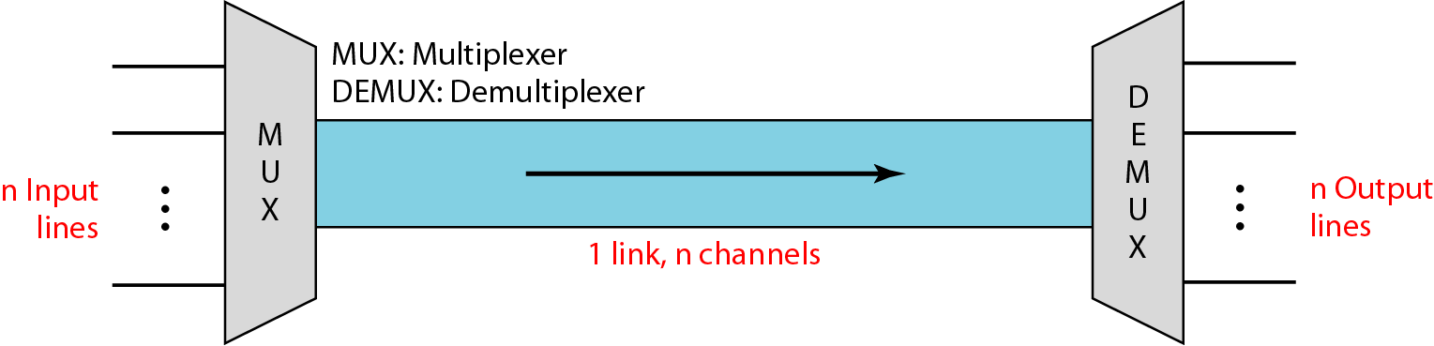
Dividing a link into channels

Slide 17
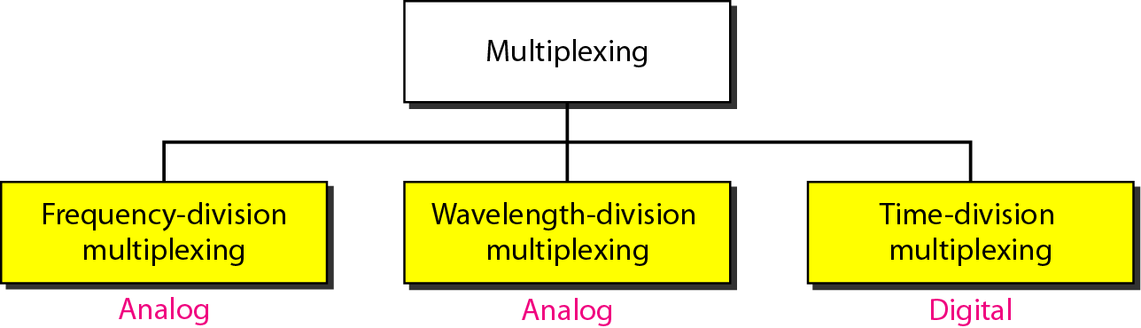
Categories of multiplexing

Slide 18
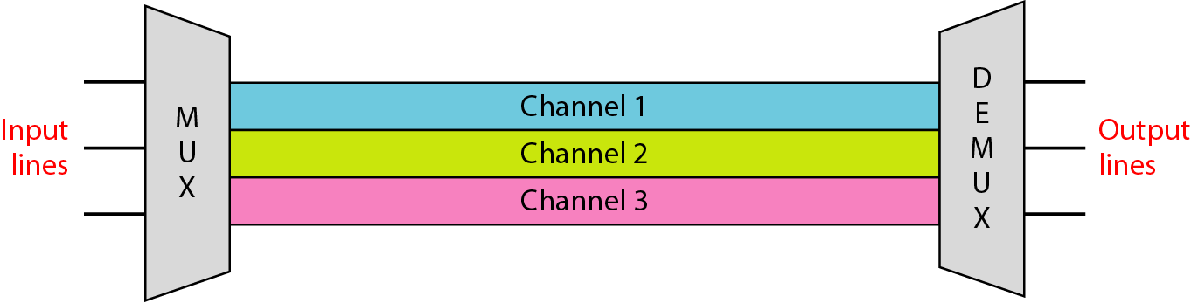
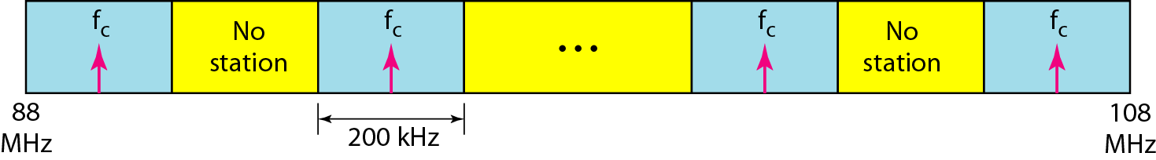
Frequency-division multiplexing (FDM)

Slide 19
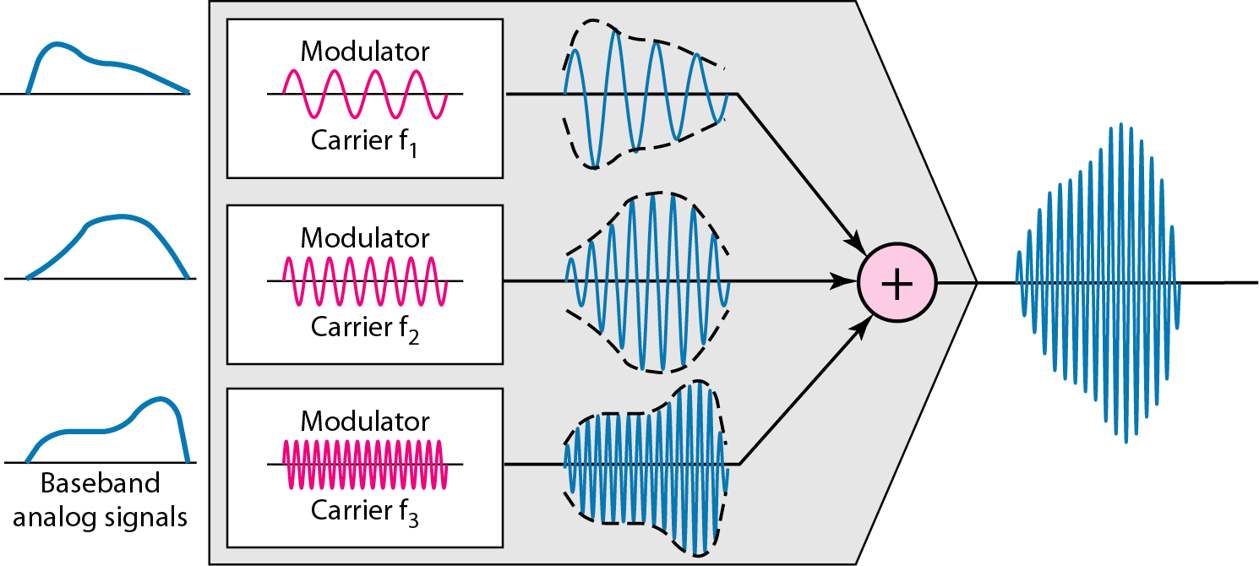
FDM Process

Slide 20
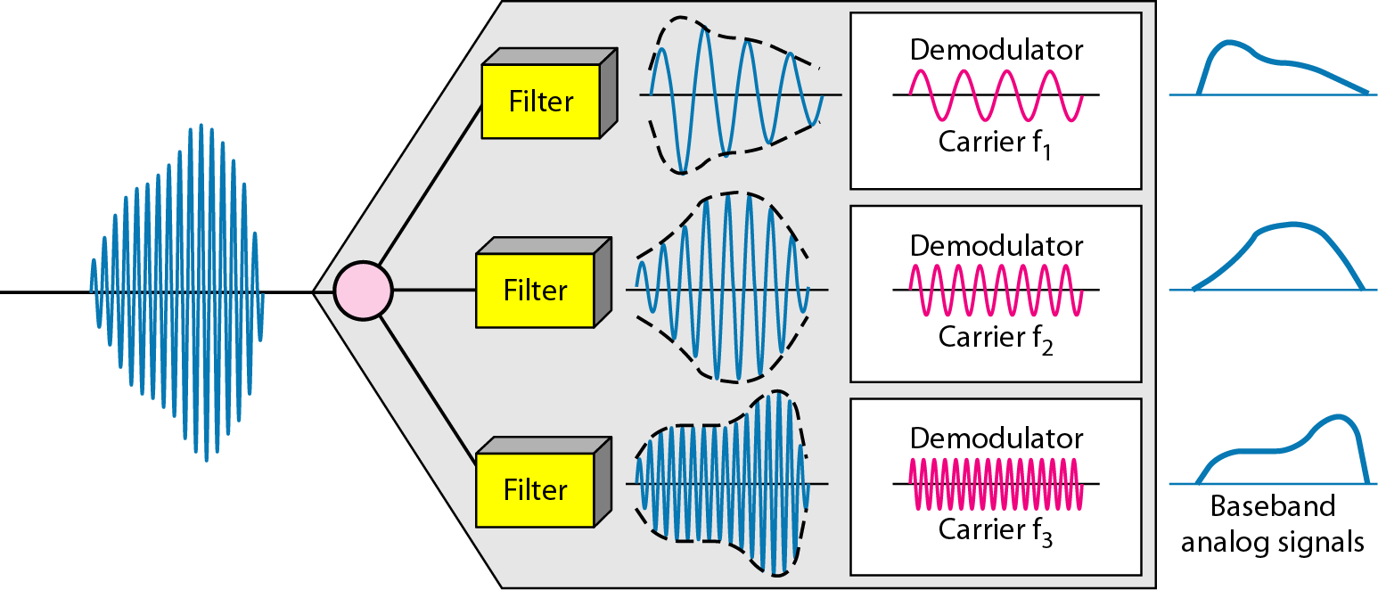
FDM demultiplexing

Slide 21
Assume that a voice channel occupies a bandwidth of 4 kHz. We need to combine three voice channels into a link with a bandwidth of 12 kHz, from 20 to 32 kHz. Show the configuration, using the frequency domain. Assume there are no guard bands.
Solution
We shift (modulate) each of the three voice channels to a different bandwidth, as shown in Figure. We use
the 20 to 24 kHz bandwidth for the first channel,
the 24 to 28 kHz bandwidth for the second channel, and
the 28 to 32 kHz bandwidth for the third one.
Then we combine them.

Slide 22
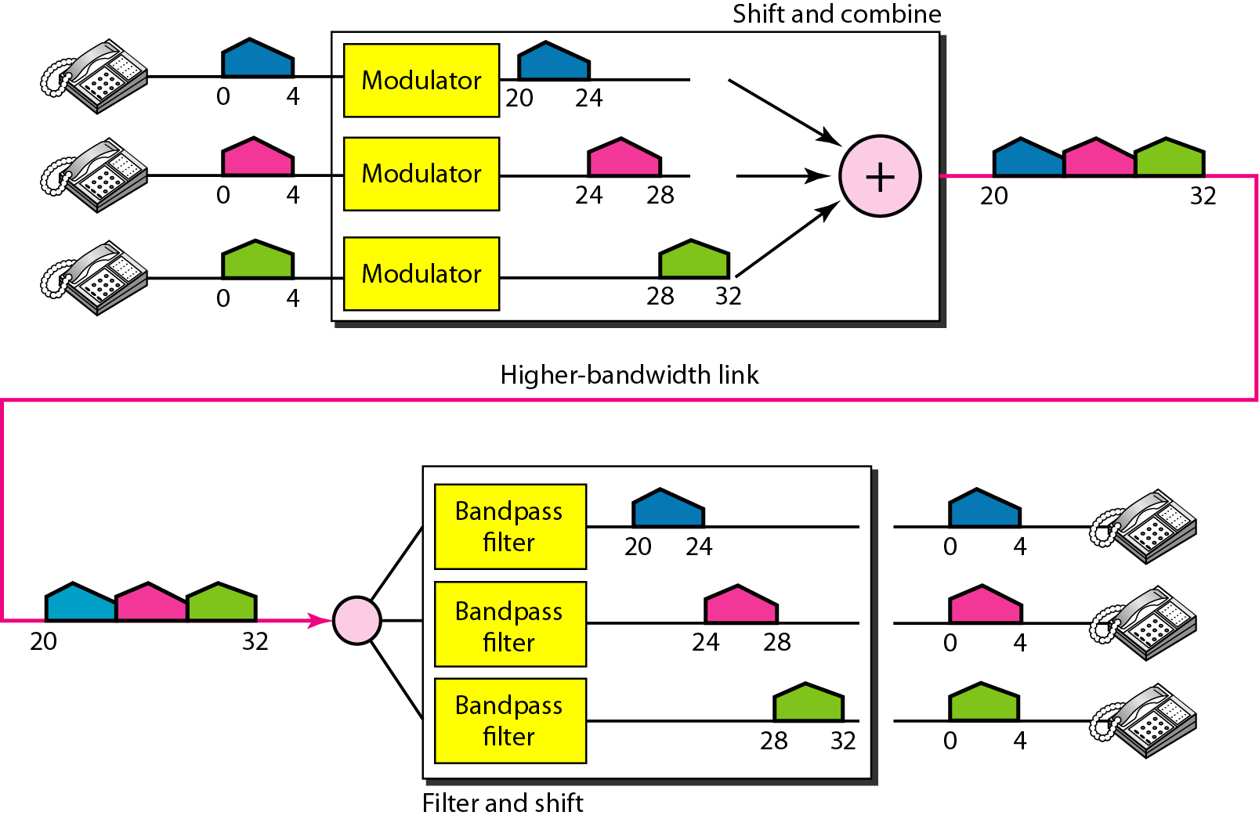
Figure 6.6 Example 6.1

Slide 23
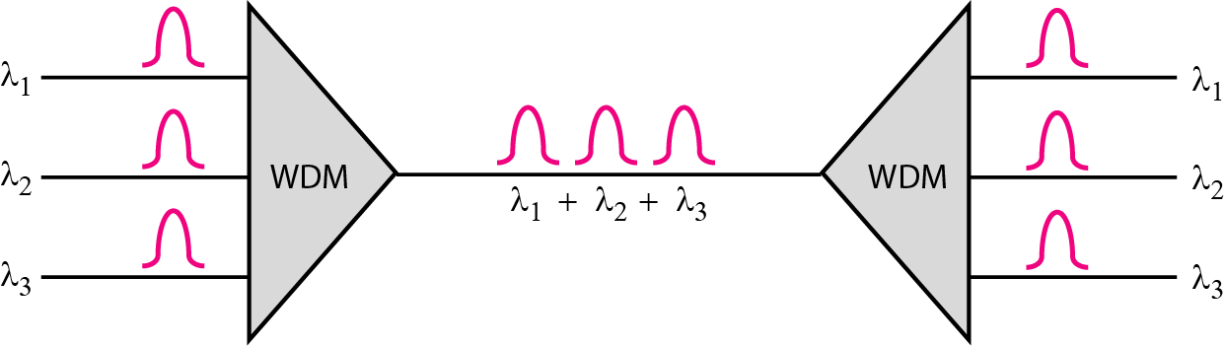
Wavelength-Division Multiplexing (WDM)

Slide 24
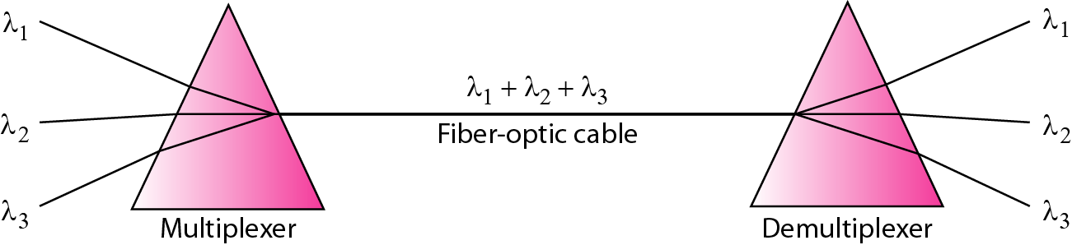
Prisms in wavelength-division multiplexing and demultiplexing

Slide 25
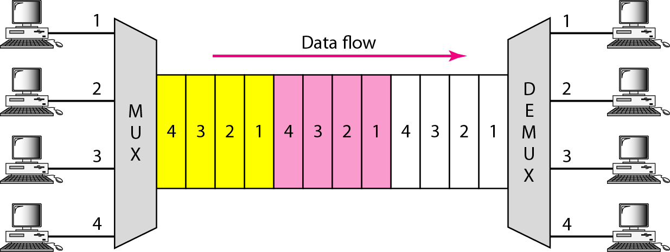
Time Division Multiplexing (TDM)

Slide 26
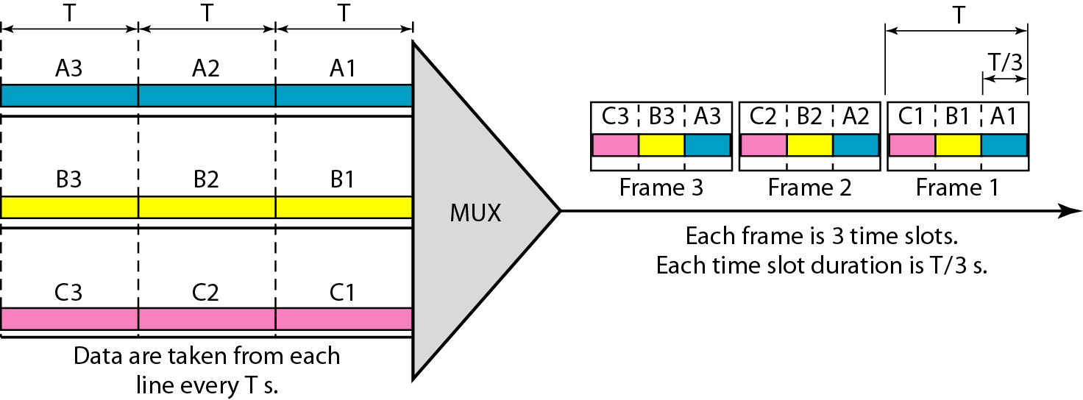
Time-Division Multiplexing

